Slide 1
Insights from Data
Lecture 2
Introduction to data science and R

Slide 2
Insights from Data
Introduction to data science
Basic of R programming: variables, data types and operations
Next steps

Slide 3
Introduction to data science
Definition: Data Science combines statistics, programming, and domain expertise to extract meaningful insights from data.
Importance: Data science is essential in business, healthcare, finance, and more for decision-making, predictive analytics, and automation.
Creative Discipline: It is not just about numbers, data science requires creativity in finding innovative solutions using data-driven approaches

Slide 4
Transforming Data into Actionable Insights
Converting Data into Meaningful Information: Start by organizing and cleaning your data to make sure it's accurate and relevant.
Conducting Thorough Data Analysis: Use statistical methods to analyze the data.
Recognizing Patterns and Trends: Identify patterns that can lead to predictions or insights.
Applying Contextual Understanding: Use domain knowledge to interpret what the data means in the real world.
Deriving Actionable Conclusions: Make sure the insights lead to practical, actionable steps.

Slide 5
Key Elements in Data Science
Programming
Statistics and Mathematics
Domain Knowledge

Slide 6
Programming
Programming skills makes your life easier
Ease of automation
Being able to customize, explore, prototype and test
Essential package to use in R
Ggplot2 for visualization

Slide 7
Statics
Understanding different types of data
Understanding key statistical terms
Types of means
Fluctuations in data
Selecting, grouping and dividing data points

Slide 8
Type of Average
Mean
Median
Mode (suitable for categorical data)

Slide 9
Type of spread
Range: The difference between the maximum and minimum values in a dataset
Variance: The average of the squared differences from the mean, reflecting the dispersion of data points.
Standard Deviation: The square root of variance, indicating the typical amount of deviation or dispersion from the mean

Slide 10
Introduction to R
CRAN: Comprehensive R Archive Network (a world wide repository system)
https://cran.r-project.org/
It provides up-to-date, version of code and documentation for R
Around 10 000 packages of R focused on just data analysis
We use RStudio, an Integrated Development Environment (IDE)
R is more than just a programming language

Slide 11
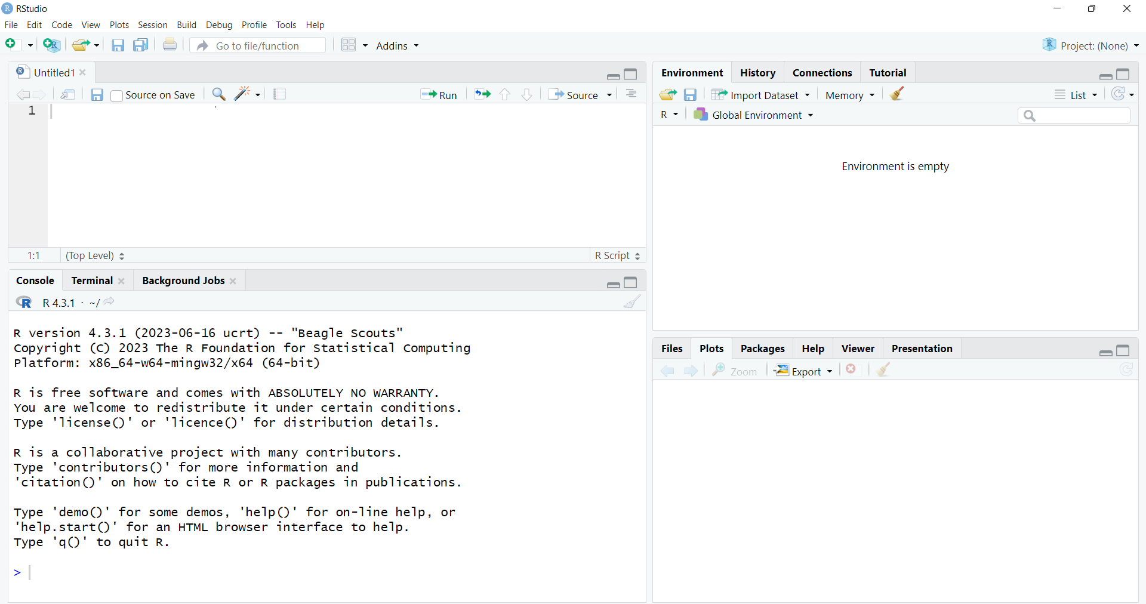
Rstudio
Four sub windows
Upper left window: R Script (for writing the codes).
Lower left window: console (for executing the codes and displaying the results).

Slide 12
R programming Fundamentals
Basic Syntax
Variables and Data Types
Operators
Data Structures
Vectors
Lists
Matrices
Data Frames

Slide 13
Data types
Numerical (discrete, continuous)
Categorical, e.g., gender, nationality
Ordinal: mixing between categorical and numerical, e.g. hotel rating

Slide 14
Packages in R
Before start programming with R, you should install packages and their dependencies
Packages provide pre-assembled collections of functions and objects, each package is hosted in CRAN repository
Not all packages are loaded by default, but they can be installed on demand

Slide 15
Assignments in R
Objects should be assigned with a name
To assign a name to a number, you use the assignment operator
“x <-”
Examples:
X <- 1
Y<- 7
Under the tab Environment once you have run those two lines you will see all R objects
ls()
[1] "X" "Y"

Slide 16
Basic data structures
Vectors: One-dimensional arrays that hold data of the same type.
Matrices: Two-dimensional arrays with data of the same type.
Data frames: Tables that organize data into rows and columns, similar to spreadsheets.
Lists: Collections that can hold different types of data.

Slide 17
Vectors
A vector in R is a sequence of elements of the same data type
A Vector can be numeric, categorical or logical
c(1, 2, 4, 5, 8, 9)
[1] 1 2 4 5 8 9

Slide 18
Subsetting Vectors
Accessing individual elements of a vector is possible by specifying their respective positions(index)
It is possible to select parts of vector
A <- c(1, 2, 4, 5, 8, 9)
A[4]
[1] 5
A[2:4]
[1] 2,4,5

Slide 19
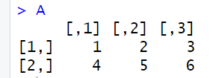
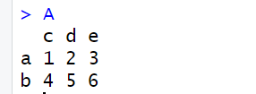
Matrices
Matrices are the objects which elements represented in a two-dimensional structure
The following way can define the syntax of a matrix in R:
matrix(value, nrow, ncol, byrow, dimnames)
Naming rows and columns in matrices
A <-matrix(c(1,2,3,4,5,6),nrow = 2, ncol = 3,byrow = TRUE)
Print(A)
rownames(A)= c("a","b")
colnames(A)= c("c","d","e“)

Slide 20
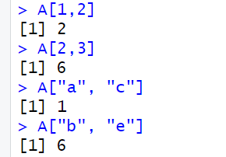
Accessing Elements in a matrix

Slide 21
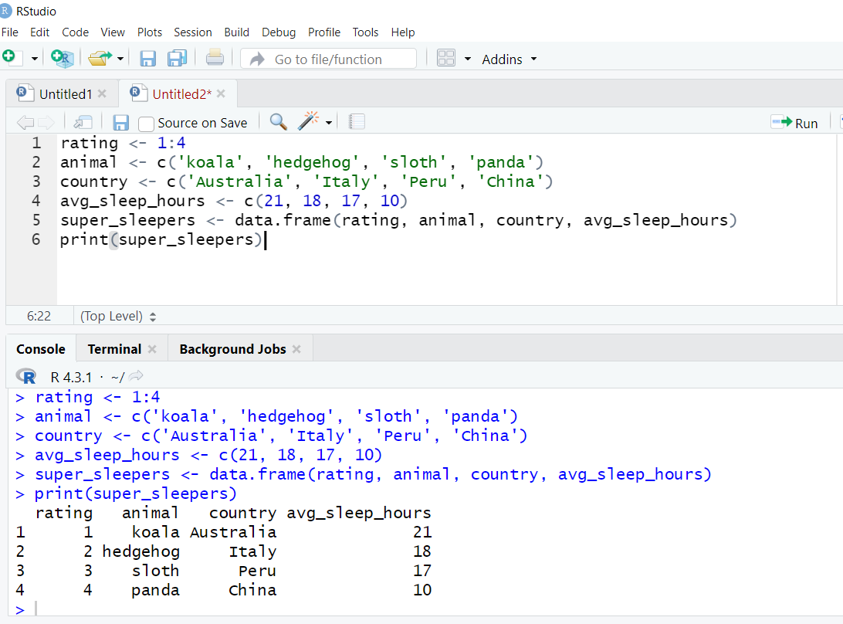
Data Frames
In R, the basic form of table is called data frame
To create a data frame in R from one or more vectors of the same length, we use the “data.frame()”
Data frame in R is a number of vectors of the same length that have been stuck together column wisely to build a table.

Slide 22
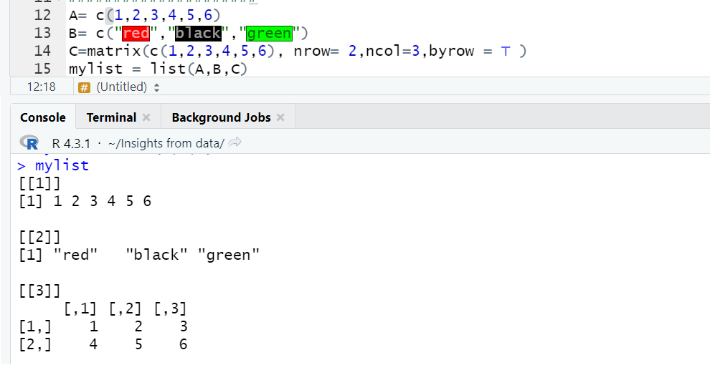
Lists
Lists are used to combine heterogeneous data
You can access a single list element by referencing its position in the list using double square brackets:
mylist[[1]]
[1] 1 2 3 4 5 6

Slide 23
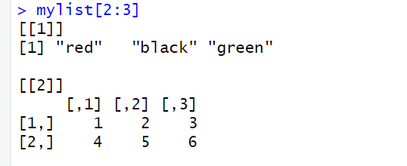
Subsetting the list
You can subset the list (i.e. keep only certain parts), by using single square brackets

Slide 24
Class exercises
Exercise: Creating a List and a Data Frame in R
Create a list that contains:
Your name (as a character)
Your age (as a numeric value)
A vector of your three favorite sports
Create a data frame that includes the following columns :
Name
Age
Favorite Sport
Highlight the Difference: What is the difference between a list and a data frame?

Slide 25
R Operators
Arithmetic Operators
Logical Operators
Relational Operators

Slide 26
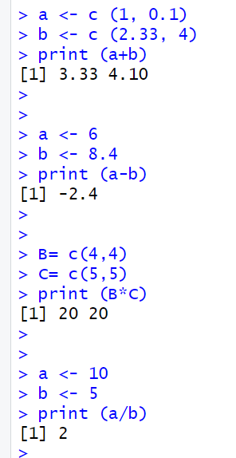
Arithmetic Operators
Addition operator (+)
Subtraction Operator (-)
Multiplication Operator (*)
Division Operator (/)

Slide 27
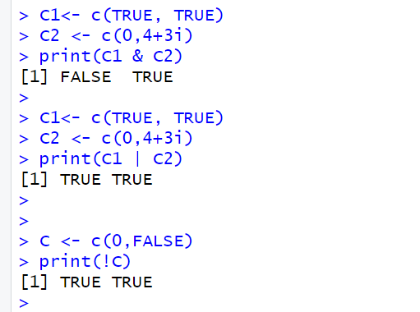
Logical Operators
Element-wise Logical AND operator (&):Returns True if both the operands are True.
Element-wise Logical OR operator (|)
NOT operator (!)

Slide 28
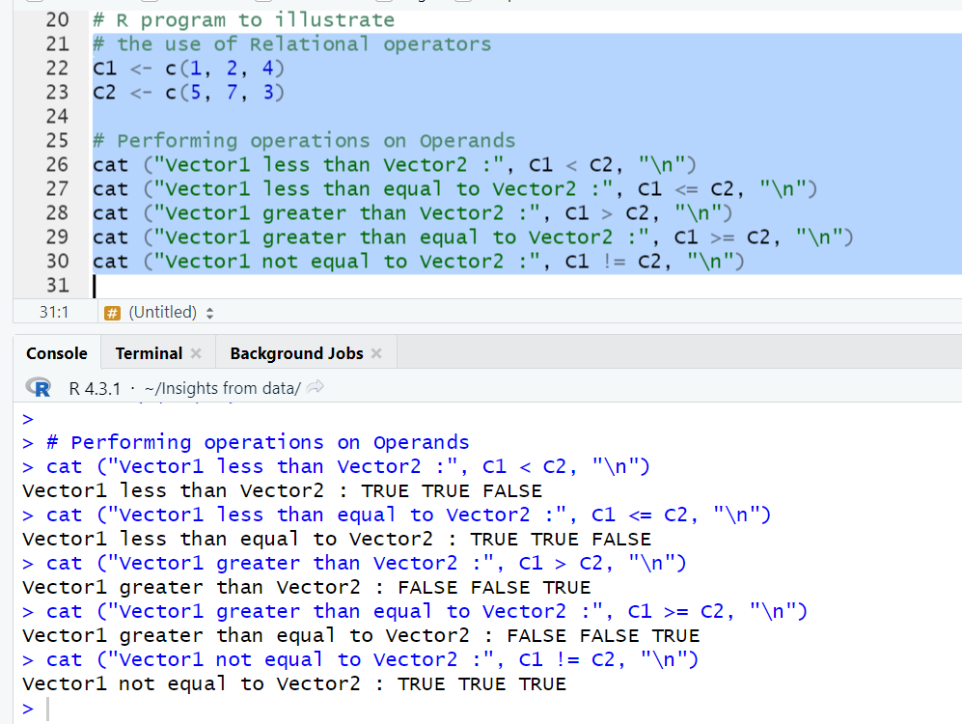
Relational Operators
Less than (<)
Less than equal to (<=)
Greater than (>)
Greater than equal to (>=)
Not equal to (!=)

Slide 29
Data exploration
Function
Structure of a function
How to use a function
Packages
Package installation

Slide 30
Class exercises
Compute (35+74)/(3*2)^2 and assign the name calculation to the result. Print the result.
Define a vector of Days containing numbers 100,245, 567, 95, 42, 385,500. Compute a vector of Months by dividing Days by 30, and again define a vector of Years by dividing Months by 12. Print the results.
The data set iris, contain information on iris flowers with three species. Load iris data to workspace with data(iris) and have a look at it with view(iris).
Create a new vector by dividing the sepal length by sepal Width and print the results.
Select a subset of data with “setosa” species (use subset function)
Create a list called x which has the objects calculation, setosa, months and years from the previous exercises as its elements.

Slide 31
Next
Data import and export
Data manipulation
Handling missing data and outliers

